Slide 1
Visitor design pattern

Slide 2

Introduction
Visitor design pattern is one of the behavioral design patterns. It is used when we have to perform an operation on a group of similar kind of Objects. With the help of visitor pattern, we can move the operational logic from the objects to another class.

Slide 3
The visitor pattern consists of two parts:
a method called Visit() which is implemented by the visitor and is called for every element in the data structure
visitable classes providing Accept() methods that accept a visitor

Slide 4
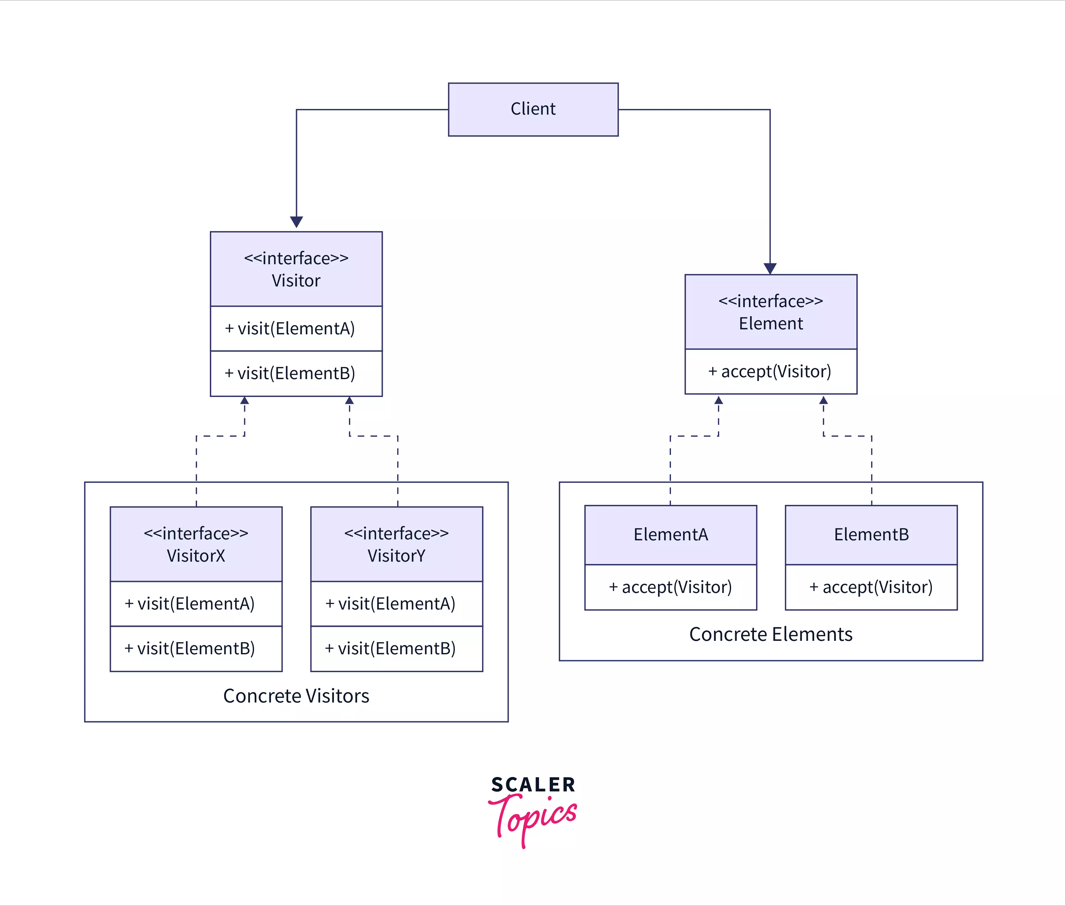
Flow

Slide 5
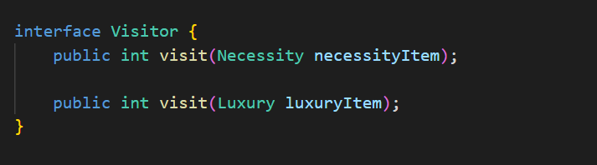
Code:

Slide 6
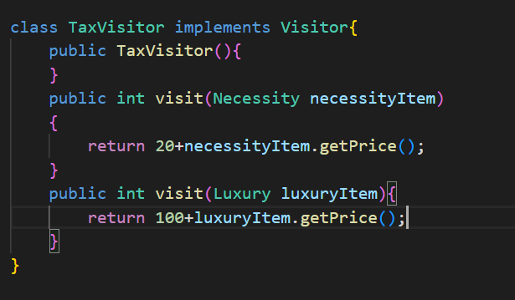
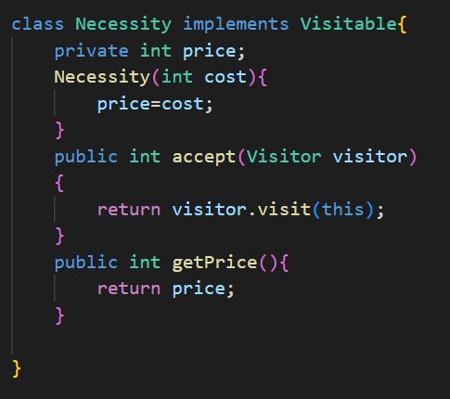
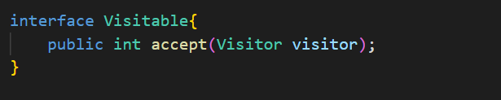

Slide 7
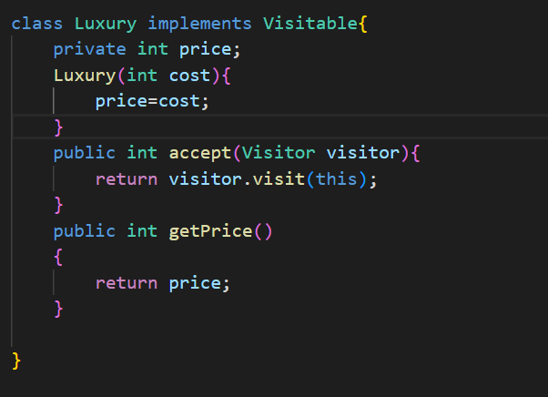
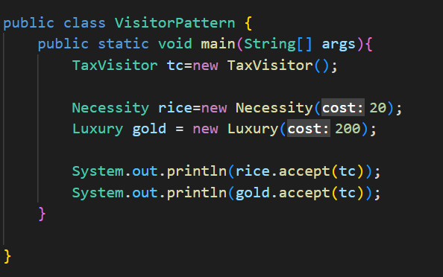

Slide 8
Thank you

